Slide 1
The Molecular Basis of Genetic Disease
Hemoglobinopathies

Slide 2
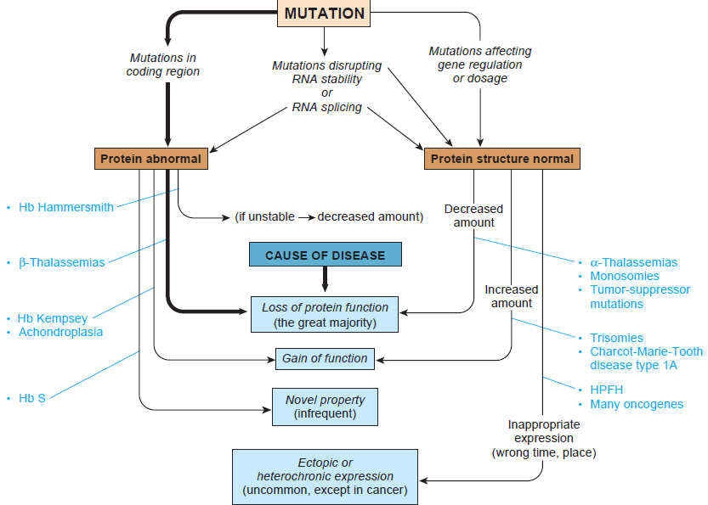
Mutations cause disease through four different effects on protein function

Slide 3
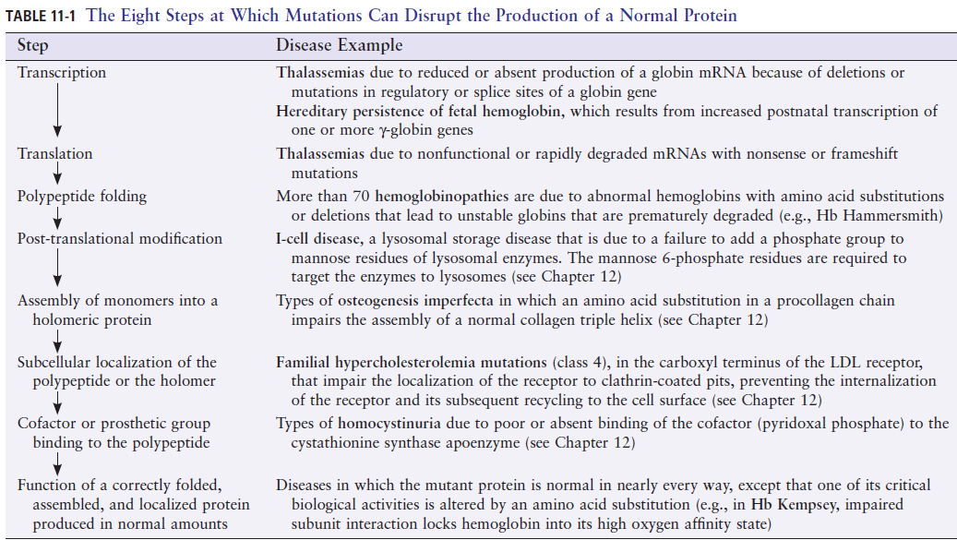

Slide 4
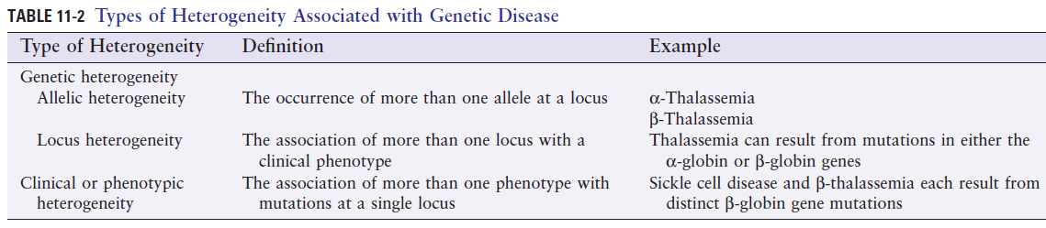
Variation in clinical phenotype may have any of three genetic explanations:
Allelic heterogeneity
Locus heterogeneity
Effect of modifier genes, e.g. β-thalassemia homozygotes who also inherit an α-thalassemia variant

Slide 5
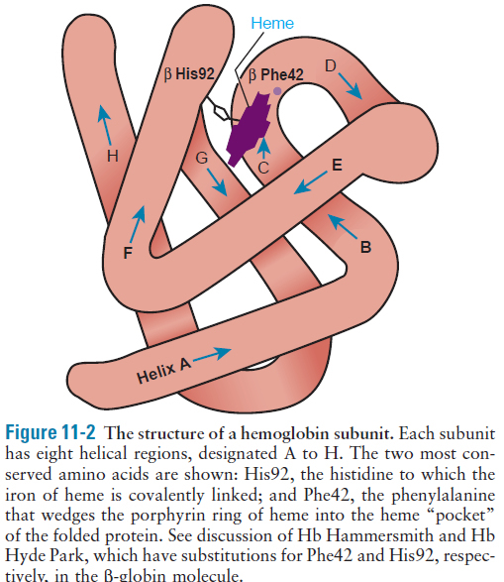
Hemoglobin is the oxygen carrier in red blood cells
Each is composed of four subunits: 2 α–globin chains and 2 β–globin chains
Each subunit is composed of a polypeptide chain, globin, and a prosthetic group, heme, an iron-containing pigment that combines with oxygen
The predominant adult hemoglobin, Hb A, has α2β2 structure, a tetramer

Slide 6
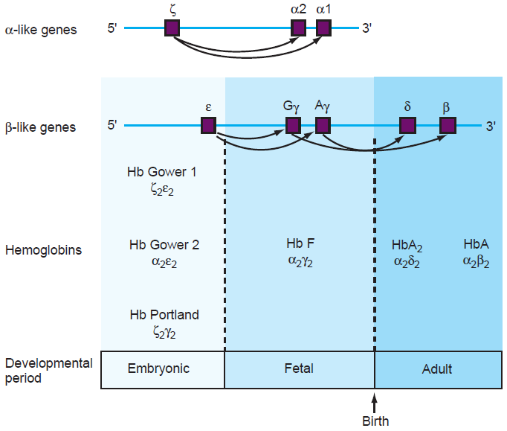
Organization of the human globin genes. α-like genes are on chromosome 16, β-like genes are on chromosome 11.

Slide 7
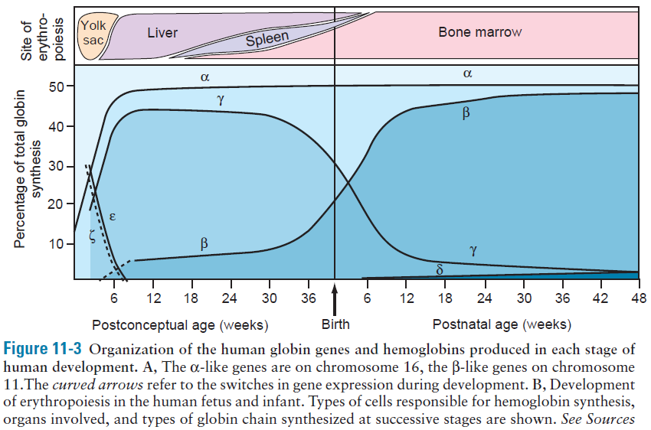

Slide 8
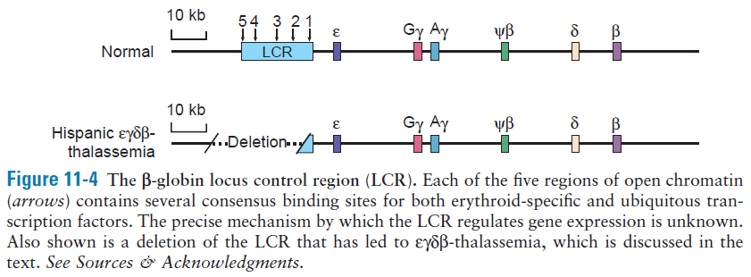

Slide 9
Gene dosage, developmental expression of globins, and clinical disease
There are four α-globin and two β-globin genes per diploid genome
β-globin mutations are more likely to cause disease than are α-globin mutations since a single β-globin mutation affects 50% of β chains, whereas a single α globin mutation affects only 25% of α chains
β-globin mutations have no prenatal consequences
α-globin mutations cause disease in both fetal and postnatal life

Slide 10
Hemoglobinopathies can be divided into three broad, overlapping, groups:
Structural variants: alter amino acid sequence, e.g. sickle cell disease
Thalassemias: decreased abundance of one or more of the globin chains, e.g. promoter mutations decreasing expression of β-globin mRNA to cause β-thalassemia
Hereditary persistence of fetal hemoglobin: clinically benign conditions that impair the perinatal switch from ɣ-globin to β-globin synthesis, e.g. deletion that removes both δ-globin and β-globin genes but leads to continued postnatal expression of ɣ-globin to produce Hb F

Slide 11
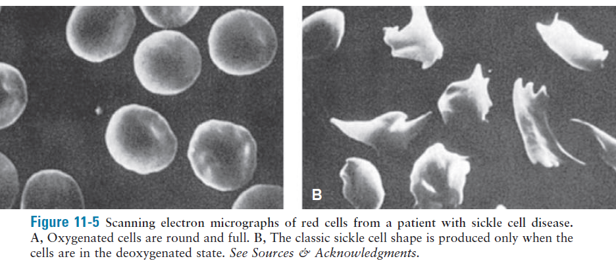

Slide 12
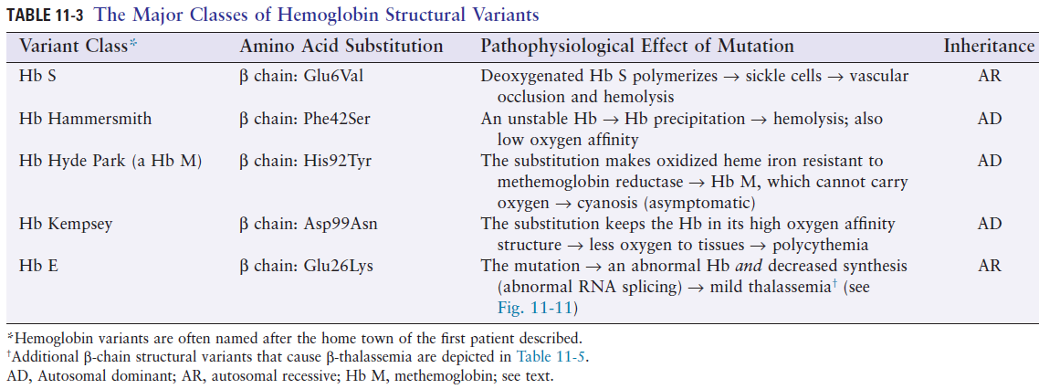
Hemoglobin structural variants separated into three classes, depending on the clinical phenotype:
Variants that cause hemolytic anemia, unstable hemoglobin
Variants with altered oxygen transport, abnormal oxygen affinity
Variants due to mutations in coding region that cause thalassemia, reduce abundance of a globin polypeptide

Slide 13
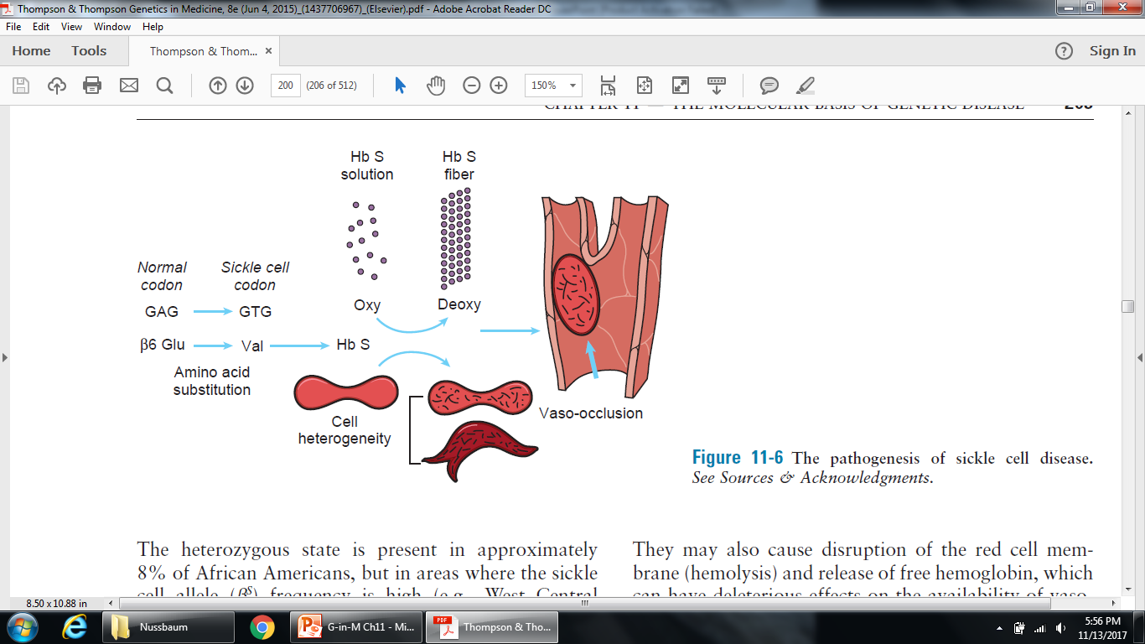
Heterozygotes have sickle cell trait

Slide 14
Modifier genes determine clinical severity of sickle cell disease
Patients level of Hb F (α₂ɣ₂) is a strong modifier of clinical severity of sickle cell disease (and β-thalassemia)
Three loci found associated with level of Hb F: ɣ-globin, BCL11A, and MYB
BCL11A is a transcription factor that normally silences ɣ-globin expression, thus shuts down Hb F production postnatally
Drugs that suppress BCL11 activity postnatally, thereby increasing Hb F, may help patients of sickle cell and β-thalassemia

Slide 15
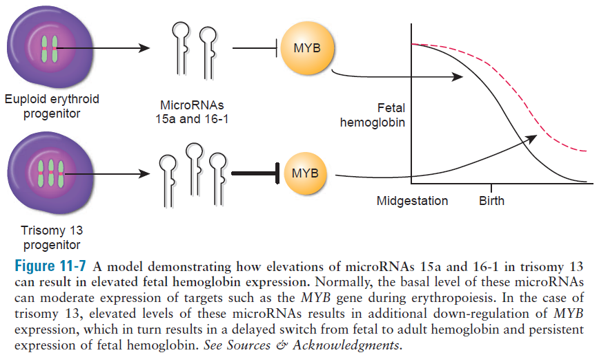
Trisomy 13, MicroRNAs, and MYB effect on ɣ-globin expression
MYB normally silences ɣ-globin expression

Slide 16
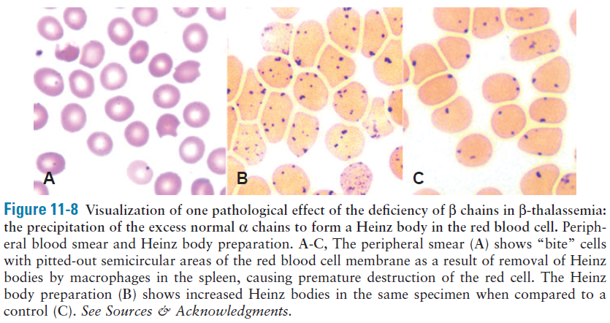
Heinz bodies: denatured globin tetramers

Slide 17
Thalassemia: an imbalance of globin-chain synthesis
Thalassemias are the most common single-gene disorders
Mutations reduce synthesis or stability of either α-globin (causing α -thalassemia) or β-globin (causing β-thalassemia)
Imbalance in the ratio α:β underlines pathophysiology
Excess normal chains precipitate in cell, damaging membrane and leading to red blood cell destruction

Slide 18
The α-Thalassemias
Affects fetal and adult hemoglobins causing intrauterine and postnatal disease
Forms homotetrameric hemoglobin, ɣ₄: Hb Bart’s or β₄: Hb H
Completely ineffective oxygen carriers
Hb Bart’s results in severe intrauterine hypoxia and infants are born with massive generalized fluid accumulation, hydrops fetalis

Slide 19
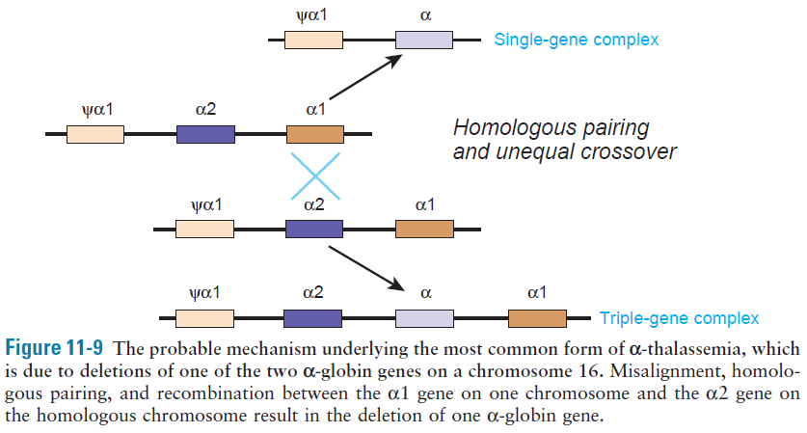
The most common forms of α-thalassemia result from deletions
Tandem homologous α-globin genes facilitates misalignment due to homologous pairing and subsequent recombination

Slide 20
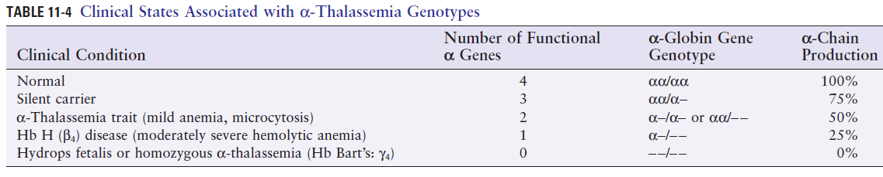
Deletions or other alterations of the α-globin genes cause a proportionately severe hematological abnormality
ATR-X syndrome (thalassemia and intellectual disability)
X-linked ATRX gene encodes a chromatin remodeling protein that activates expression of α-globin genes

Slide 21
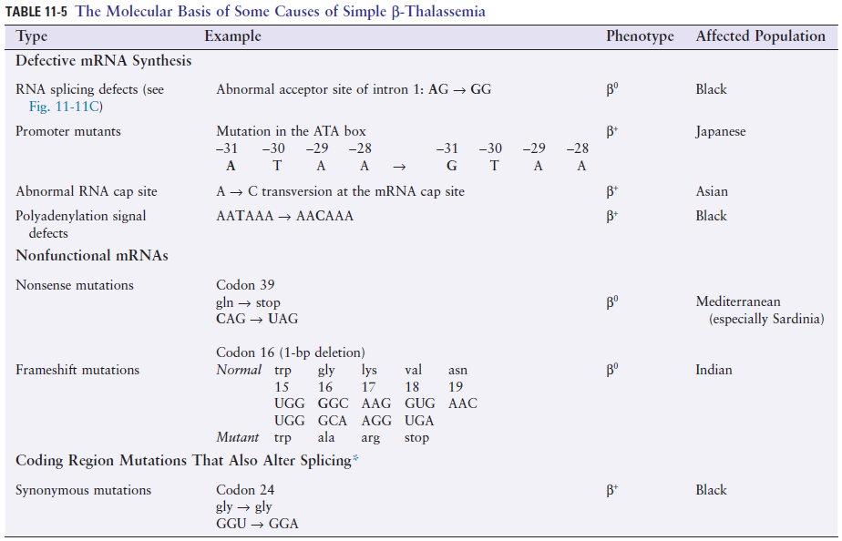
β-thalassemias are usually due to single base pair substitutions

Slide 22
Most individuals with two β-thalassemia alleles have thalassemia major, severe anemia and need of lifelong medical management
Β⁰-thalassemia: so little production of β-globin that no Hb A is present
β⁺-thalassemia: some Hb A is detectable
Treatment is based on blood transfusion and control of consequent iron accumulation by administration of chelating agents, or, if possible, bone marrow transplantation
Carriers of one β-thalassemia allele are clinically well and are said to have β-thalassemia minor, diagnosed by hemoglobin electrophoresis showing increased Hb A2 (α₂δ₂)

Slide 23
The clinical severity of the β-thalassemia is sometimes ameliorated by the presence of the α-thalassemia allele, which acts as a modifier gene
Simple β-thalassemia, defects impairing production of β-globin alone
Complex thalassemias, β-globin gene as well as one or more other genes, or the LCR, in the β-globin cluster is removed

Slide 24
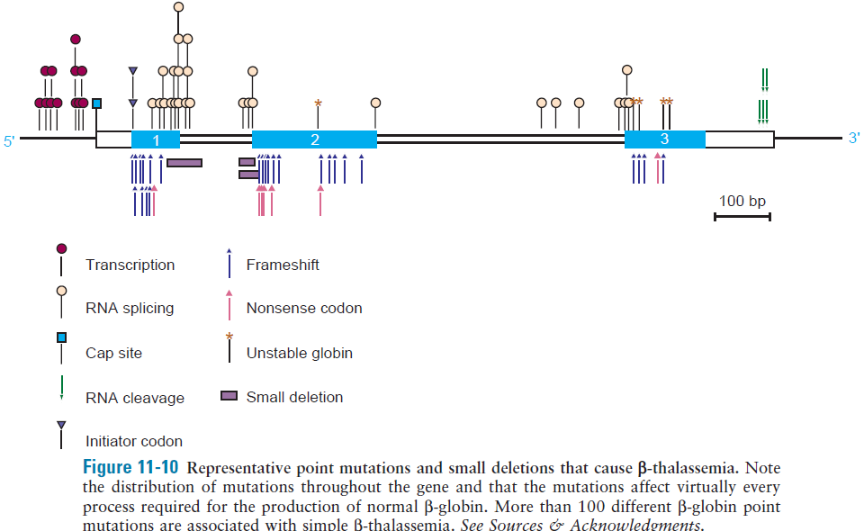
Multiple molecular defects, primarily point mutations, in β-globin gene results in simple β-thalassemia

Slide 25
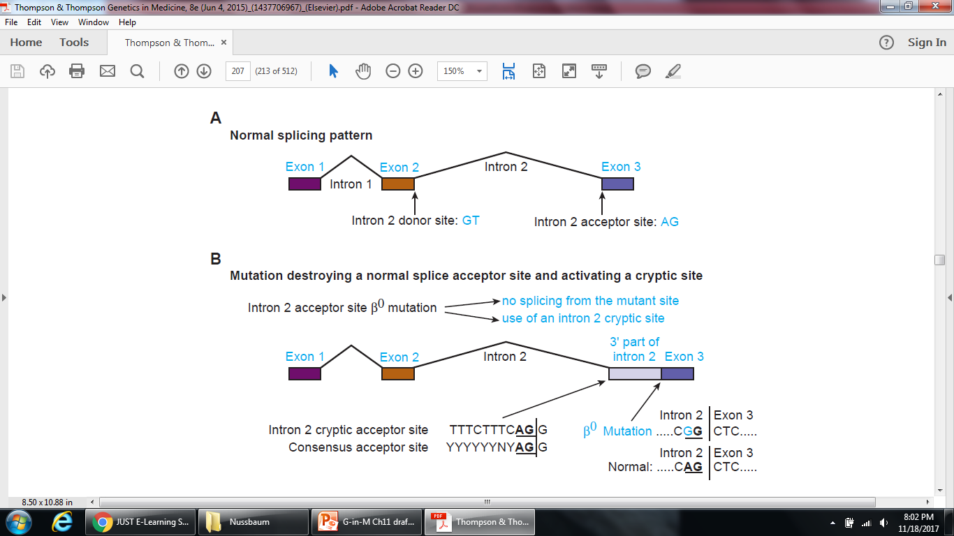
Examples of mutations that disrupt normal splicing of the β-globin gene to cause β-thalassemia.

Slide 26
Splice junction mutations
An intron 2 mutation (IVS2-2A>G) in the normal splice acceptor site aborts normal splicing

Slide 27
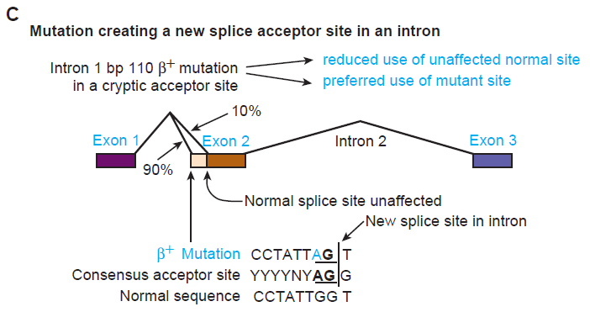
Intron mutations
An intron 1 mutation (G > A in base pair 110 of intron 1) activates a cryptic acceptor site by creating an AG dinucleotide and increasing the resemblance of the site to the consensus acceptor sequence

Slide 28
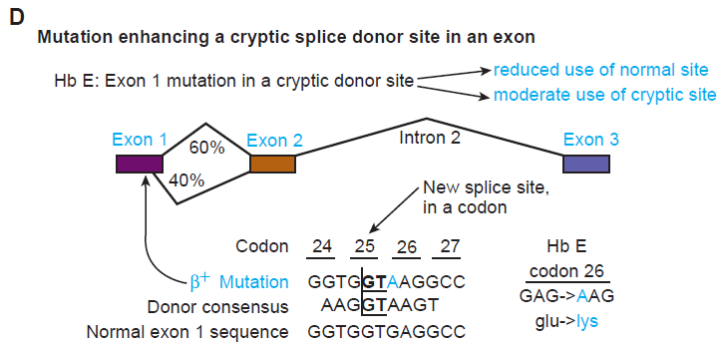
Coding sequence changes that also affect splicing
In the Hb E defect, the missense mutation (Glu26Lys) in codon 26 in exon 1 activates a cryptic donor splice site in codon 25 that competes effectively with the normal donor site

Slide 29
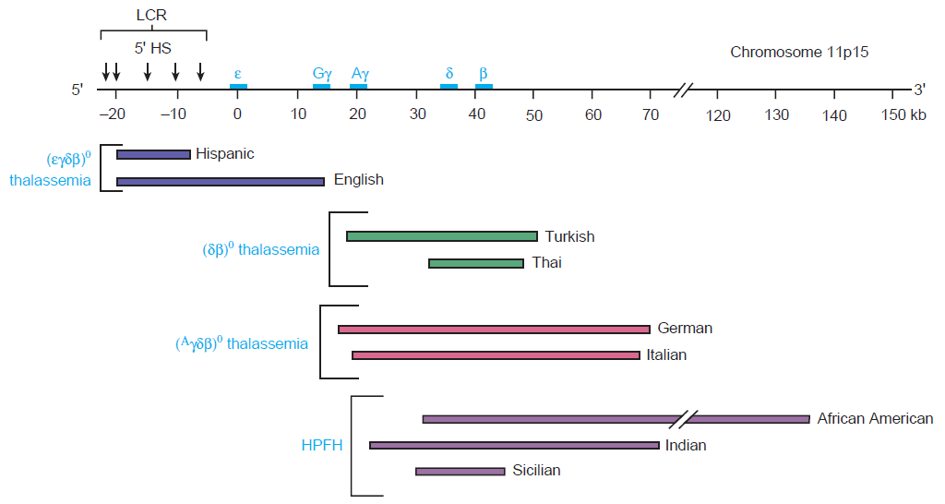
Complex thalassemias and HPFH

